Slide 1

Unveiling Customer Purchase Patterns with Random Forest Analysis
By: Vezhavendhan VS

Slide 2

Problem Statement
Develop a Random Forest model to predict customer purchase behavior in retail. Utilize historical customer data including demographics, past purchases, and behavior patterns. Aim to identify key features influencing purchase decisions such as product preferences, pricing strategies, and promotional offers. Evaluate the model's accuracy and performance metrics to enhance marketing strategies and optimize sales efforts. Implement insights from the model to personalize recommendations and improve customer satisfaction and retention.

Slide 3

Project Overview
The project aims to predict customer purchase behavior in the retail industry using the Random Forest algorithm. This involves leveraging historical customer data such as demographics, browsing history, purchase history, and other relevant features to build a predictive model. The Random Forest algorithm is chosen for its ability to handle large datasets, nonlinear relationships, and feature importance analysis like
Data Cleaning & Transformation
Data Preprocessing
Customer Segmentation
Cluster Analysis & Evaluation
Recommendation System

Slide 4
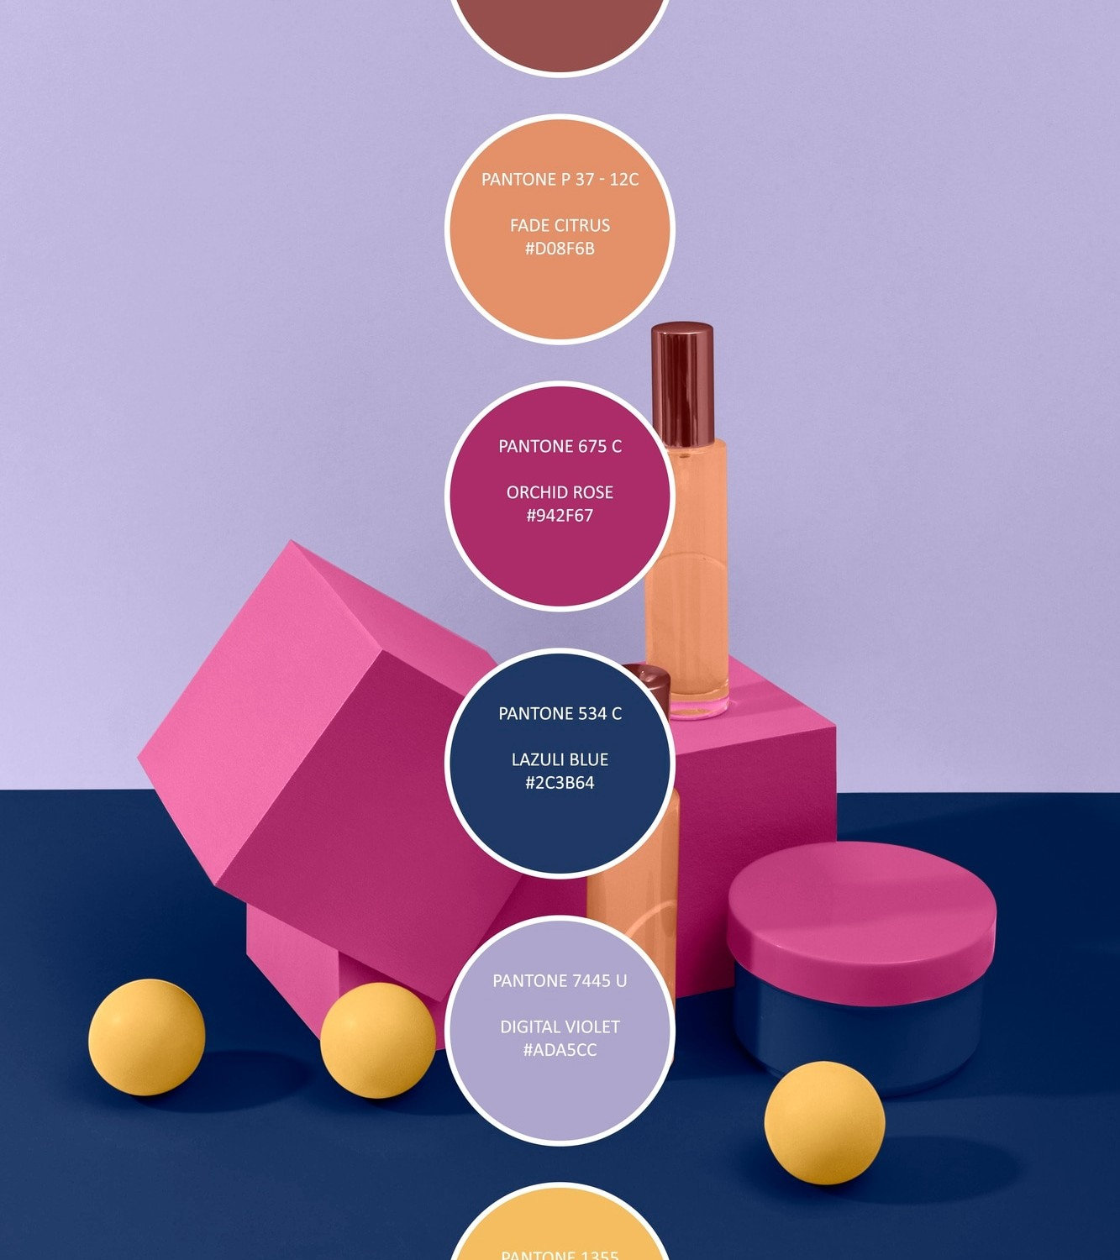
End users Scenario
Retail marketers aiming to target specific customer segments effectively.
Sales teams interested in optimizing product recommendations and promotions.
Customer service teams seeking to improve personalized interactions and satisfaction.
Supply chain managers looking to forecast demand and manage inventory efficiently.
Financial analysts interested in predicting revenue and profitability trends.
E-commerce platforms aiming to enhance the overall customer experience.
Retail executives focused on making data-driven decisions to drive business growth and competitivenes

Slide 5

Predictive Modeling with Random Forest
Through Random Forest Analysis, we can build robust predictive models to forecast customer purchase patterns. By harnessing the power of ensemble learning, this approach offers high accuracy and generalizability, enabling businesses to anticipate consumer trends effectively.

Slide 6
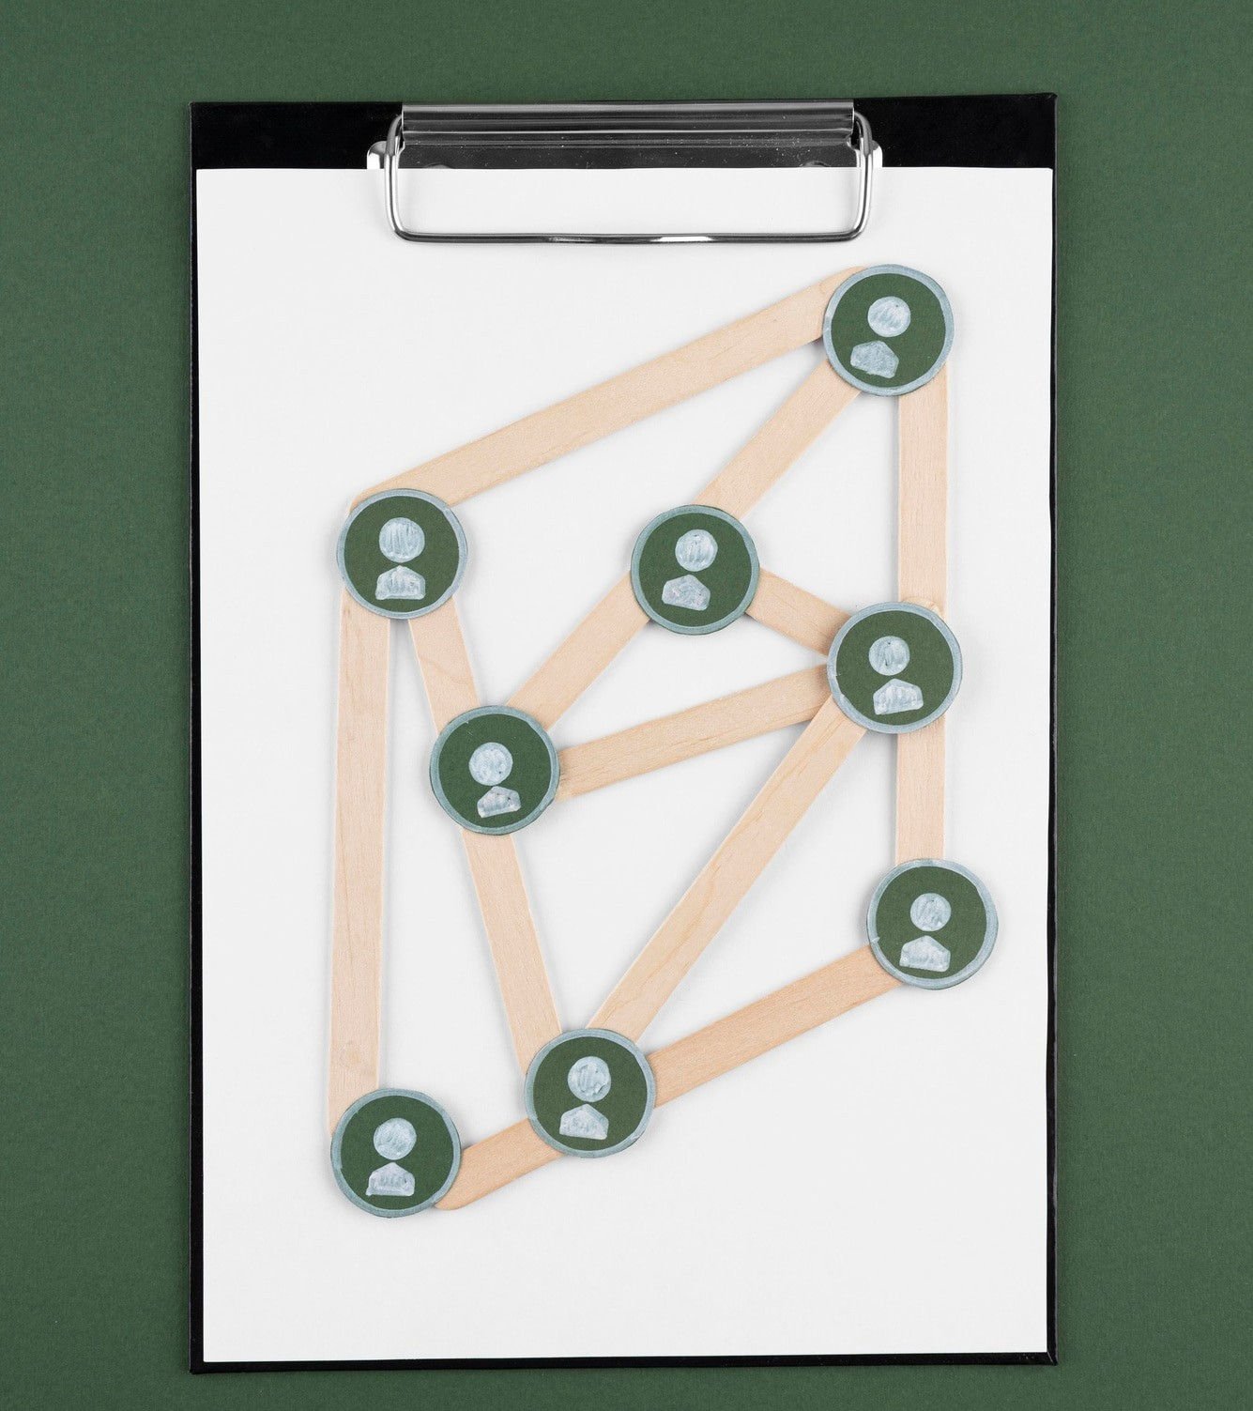
Solution and Value
Random Forest Analysis empowers businesses to optimize their by tailoring promotions and campaigns based on identiﬁed customer purchase patterns. This data-driven approach enhances customer engagement and maximizes marketing ROI.

Slide 7

While Random Forest Analysis offers substantial beneﬁts, it is essential to address potential challenges such as and model interpretability. Careful consideration of these factors is crucial in ensuring the reliability and relevance of the derived insights. The end users for predicting customer purchase behavior in retail using Random Forest truly showcase the diverse applications and impact of this advanced technology in the retail industry."
WOW in the Solution

Slide 8

Case Study: Retail Industry Application
We will explore a real-world case study showcasing the application of Random Forest Analysis in the retail industry. By examining how this approach unveils customer purchase patterns, we gain valuable insights into consumer behavior and its impact on business decisions.

Slide 9
Conclusion
Random Forest Analysis offers a powerful framework for unveiling intricate customer purchase patterns, enabling businesses to make data-driven decisions that enhance customer engagement and drive revenue growth. By leveraging this approach, organizations can gain a deeper understanding of consumer behavior and optimize their strategies for long-term success.

Slide 10
Thanks!

